Slide 1

DATA ANALYSIS PROJECT
BY MEHTAB ALAM WARSI
GROUP 2

Slide 2
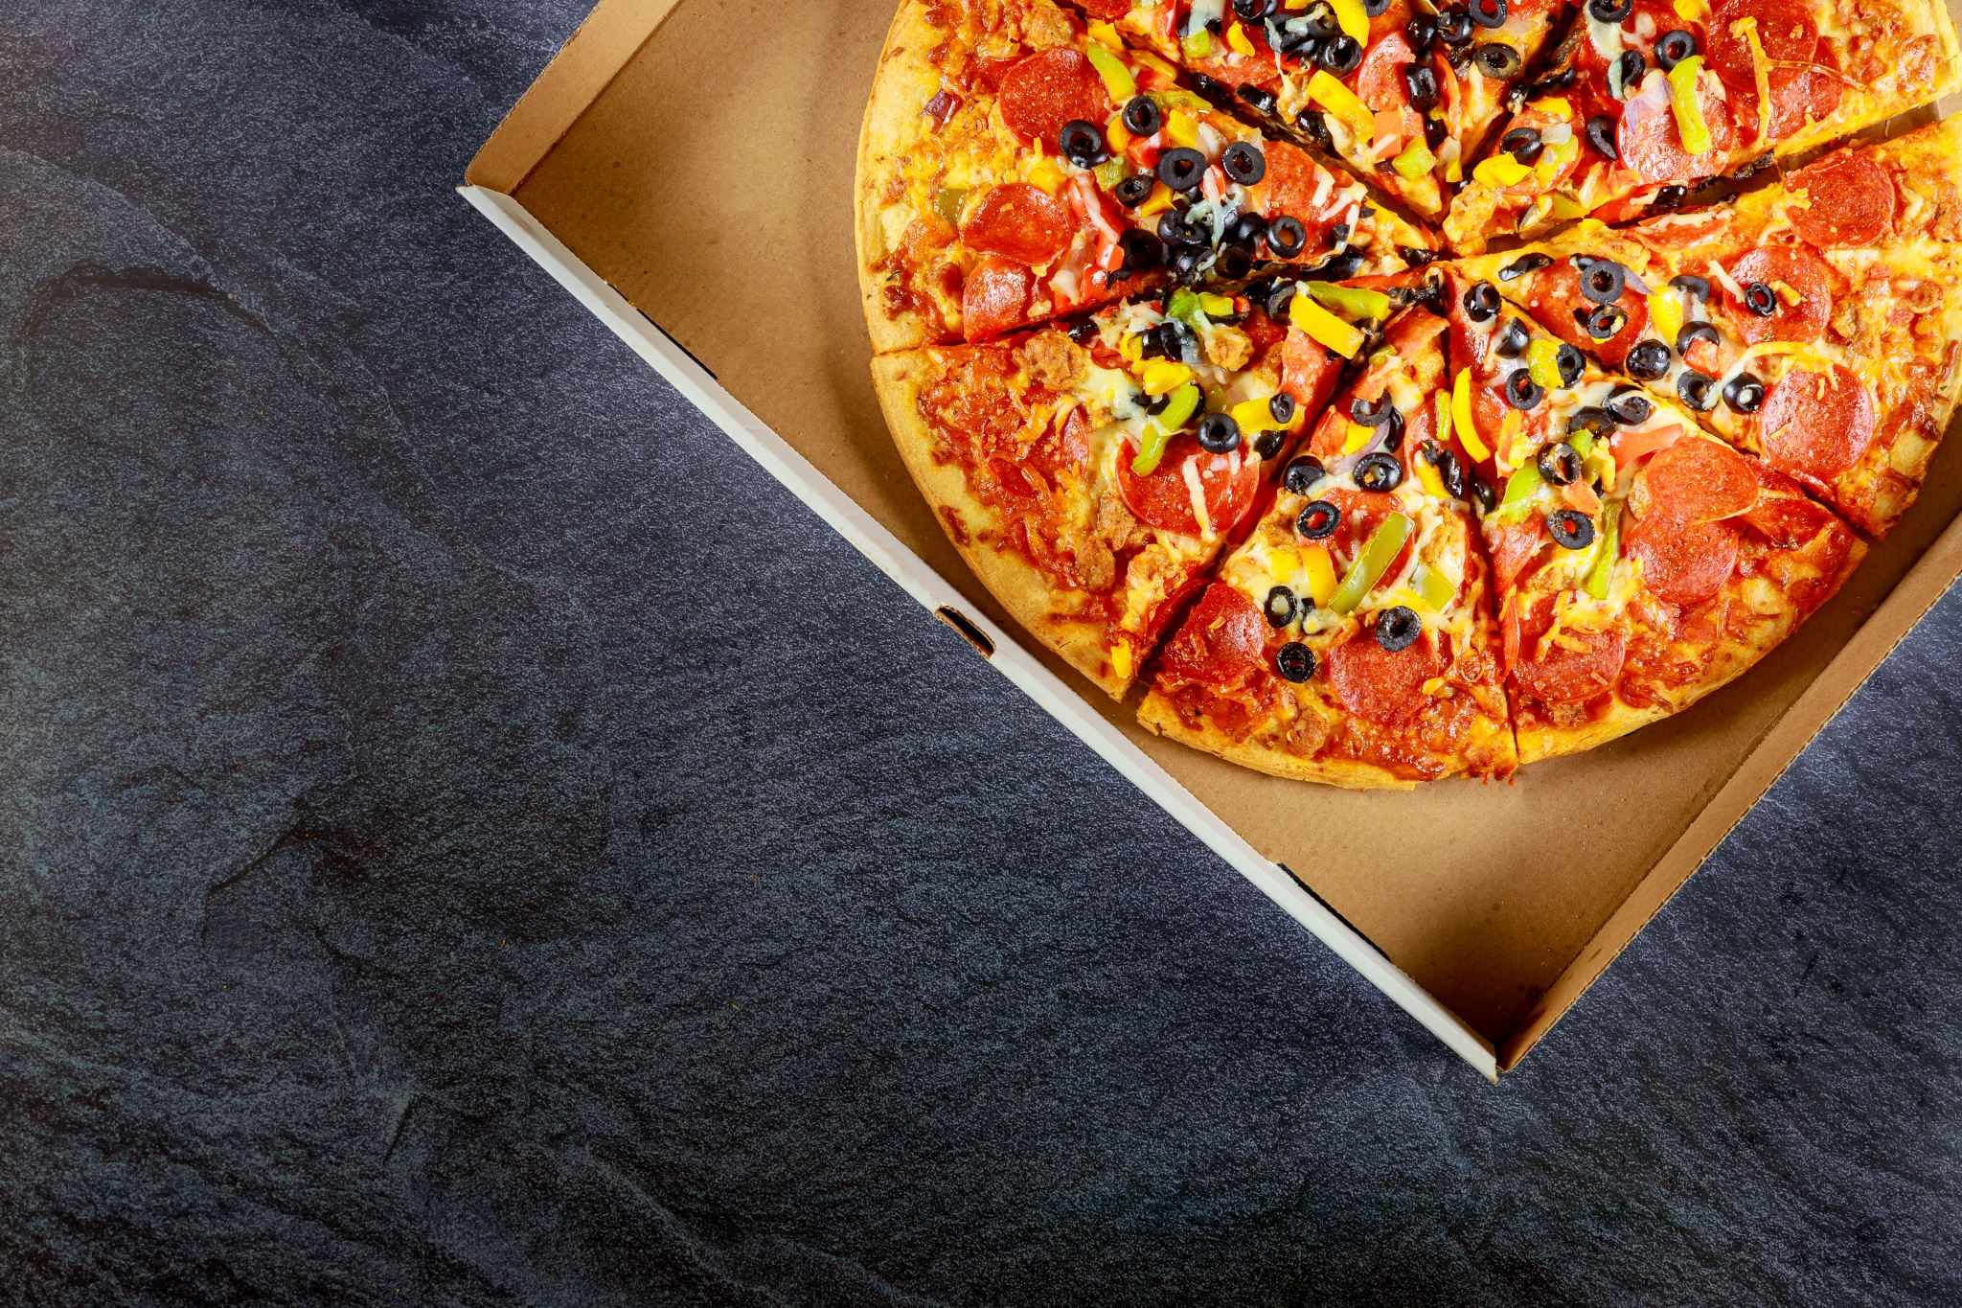
KPIZZA
KPIZZA is an Indian brand of Pizza place. It offers variety of veg and non-veg pizzas such as Chicken Pizza, Veggi pizzas, Spicy Paneer pizzas and Margherita pizzas along with various modes of payments and delivery options. The Brand has 4 outlets across the city operating from Morning to Evening.
Since the Brands database had huge amount of raw and unstructured data from 2018 to 2020 without the data analyst so, the management team/Director wanted to retrieve insights from the raw data to improve revenue and rectify the loopholes in their business. So, They hired a Data Analyst.

Slide 3
STEPS INVOLVED IN DATA ANALYSIS
Understanding the Business Requirement.
Data Collection/Extraction.
Data Cleaning/Data Pre-processing.
Data Exploration and Validation.
Data Visualization.
Interpreting the result.

Slide 4

DATA COLLECTION/EXTRACTION
Customer_Name | Review | Mob | Email | Payment_Mode | Order_Id | Pizza_Type | Location | Price | Order_Date | Total_Amount | Order_Time | Gender
Raj Sharma | Good | 9906960566 | Raj@gmail.com | Online | 753 | Chicken Pizza | BTM | 200 | 5-Dec-18 | 700 | 11:00:00 AM | Male
Sharad Gandhi | Average | 5900874374 | Sharad@rediffmail.com | Cash | 109 | Veggi Pizza | BTM | 150 | 18-Jun-18 | 600 | 11:05:00 AM | Female
Danish D'Souza | Bad | 453601168 | Danish@gmail.com | Cash | 124 | Spicy Panner Pizza | Kormangala | 140 | 3-Feb-18 | 600 | 11:10:00 AM | Male
Deepthi Kelley | Bad | 1032274597 | Deepthi@rediffmail.com | Cash | 161 | Spicy Panner Pizza | Maratthahalli | 140 | 13-May-18 | 267 | 12:05:00 PM | Female
Rijo Paul | No Review | 1664438923 | Rijo@gmail.com | Online | 533 | Chicken Pizza | BTM | 200 | 11-Mar-18 | 400 | 11:25:00 AM | Male
Joseph P | Excellent | Not Available | Joseph@yahoo.com | Online | 773 | Veggi Pizza | J.P Nagar | 150 | 29-Mar-18 | 387 | 11:30:00 AM | Male
Aakash Patel | Excellent | 867038371 | Aakash@gmail.com | Online | 135 | Spicy Panner Pizza | BTM | 140 | 17-Mar-18 | 400 | 11:35:00 AM | Male
Ganesh Rahu | Excellent | 673760051 | Ganesh@g.com | Cash | 829 | Margherita Pizza | BTM | 120 | 5-Feb-18 | 181 | 11:40:00 AM | Male
Vinudas K.S | No Review | 9671602033 | Vinudas@rediffmail.com | Online | 370 | Veggi Pizza | J.P Nagar | 150 | 29-Mar-18 | 500 | 11:45:00 AM | Male
Divya Kumar | Good | 777063935 | Divya@gmail.com | Online | 885 | Spicy Panner Pizza | Maratthahalli | 140 | 17-Jul-18 | 1600 | 11:50:00 AM | Female
Shilpa R | Average | 9446055414 | Shilpa@rediffmail.com | Online | 480 | Chicken Pizza | Kormangala | 200 | 12-Dec-18 | 500 | 11:55:00 AM | Female
Sindhu J.P | Bad | 6579979894 | Sindhu@rediffmail.com | Cash | 942 | Veggi Pizza | BTM | 150 | 9-Nov-18 | 600 | 12:00:00 PM | Female
Deepthi Kelley | Bad | 1032274597 | Deepthi@rediffmail.com | Cash | 161 | Spicy Panner Pizza | Maratthahalli | 140 | 13-May-18 | 267 | 12:05:00 PM | Female
Lijin k c | Average | 7381285565 | Lijin@gmail.com | Online | 486 | Margherita Pizza | BTM | 120 | 6-Oct-18 | 800 | 12:10:00 PM | Female
Sayad Kelley | Average | 7034071342 | Sayad@rediffmail.com | Online | 515 | Chicken Pizza | Kormangala | 200 | 7-Sep-18 | 500 | 12:25:00 PM | Male
Ajil k Mohanan | Excellent | Not Available | Ajil@rediffmail.com | Online | 295 | Veggi Pizza | BTM | 150 | 8-Jul-18 | 700 | 12:30:00 PM | Male
Edison ML | Excellent | 9716982309 | Edison@y.com | Online | 200 | Chicken Pizza | Maratthahalli | 200 | 2-Mar-18 | 1600 | 12:35:00 PM | Male
Basil P E | No Review | 7722885079 | Basil@yahoo.com | Cash | 326 | Margherita Pizza | Kormangala | 120 | 14-May-18 | 1600 | 12:40:00 PM | Male
Jobin George | Good | 3708983713 | Jobin@gmail.com | Cash | 482 | Spicy Panner Pizza | BTM | 140 | 26-Mar-18 | 1000 | 12:45:00 PM | Male
Jismon Sharma | Excellent | 1369353147 | Jismon@y.com | Online | 503 | Chicken Pizza | Maratthahalli | 200 | 6-Aug-18 | 1600 | 12:50:00 PM | Male
Getting Email From Sales Team of KPIZZA
Downloading & Importing Master Data in csv format from Email into Excel File.
Ensure the data is accurate, complete, and representative of the problem.

Slide 5
Data cleaning/pre-processing
Now in Excel we are Cleaning and Preprocessing the data to remove errors, inconsistencies, handling missing values, finding null values and outliers to ensure that it is accurate, reliable, and suitable for analysis.
This step is crucial for ensuring the quality of your analysis.
We have changed the attributes of some Columns and fill the missing values in location and Customer Review Column using Patterns and Autofill's for text, As we can't use imputation method for text values.
We had Standardize and normalize our data to bring it to a common scale or format. This is essential when working with features that have different units or ranges.

Slide 6
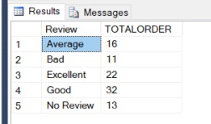
DATA EXPLORATION AND VALIDATION
Importing our cleaned and structured Dataset into DATABASE MICROSOFT SQL for doing Query through Analysis, more data cleaning and validation.
Performing SQL queries on the loaded Database…..
CUSTOMER FEEDBACK ANALYSIS------
SELECT Review, COUNT(DISTINCT Order_Id) AS TOTALORDER FROM PIZZA GROUP BY Review;

Slide 7
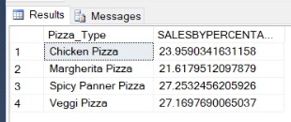

% OF SALES BY PIZZA ANALYSIS-----
SELECT Pizza_Type,sum(Total_Amount) * 100/(select sum(Total_Amount) from PIZZA) AS SALESBYPERCENTAGE FROM PIZZA GROUP BY Pizza_Type;
% OF SALES BY LOCATION ANALYSIS---
SELECT Location,sum(Total_Amount) * 100/(select sum(Total_Amount) from PIZZA) AS SALESBYPERCENTAGE FROM PIZZA GROUP BY Location;

Slide 8
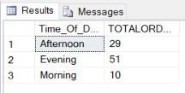
HOURLY-TREND ANALYSIS----
SELECT
CASE
WHEN DATEPART(HOUR, Order_Time) >= 10 AND DATEPART(HOUR, Order_Time) < 12 THEN 'Morning'
WHEN DATEPART(HOUR, Order_Time) >= 12 AND DATEPART(HOUR, Order_Time) < 15 THEN 'Afternoon'
ELSE 'Evening'
END AS Time_Of_Day,
COUNT (DISTINCT Order_Id) AS TOTALORDER
FROM PIZZA
GROUP BY
CASE
WHEN DATEPART(HOUR, Order_Time) >= 10 AND DATEPART(HOUR, Order_Time) < 12 THEN 'Morning'
WHEN DATEPART(HOUR, Order_Time) >= 12 AND DATEPART(HOUR, Order_Time) < 15 THEN 'Afternoon'
ELSE 'Evening'
END;

Slide 9
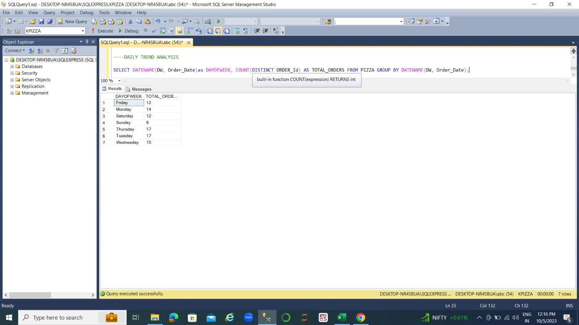
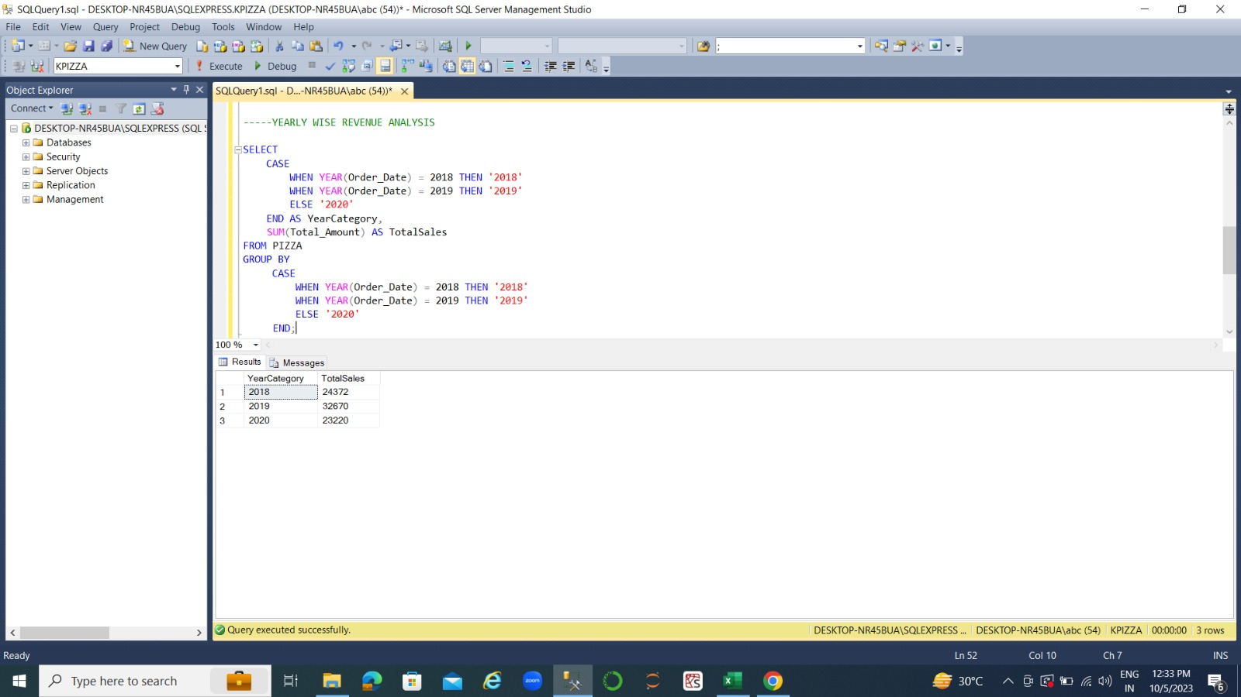
DAILY-TREND ANALYSIS-----
SELECT DATENAME(DW, Order_Date)as DAYOFWEEK, COUNT(DISTINCT ORDER_Id) AS TOTAL_ORDERS FROM PIZZA GROUP BY DATENAME(DW, Order_Date);
YEARLY-WISE REVENUE ANALYSIS----

Slide 10
DATA VISUALIZATION
EXPORTING DATA INTO EXCEL:- Now exporting the final valid data as per the business requirement into Excel file from SQL Server Database and creating Data Visualization using Pivot Charts.
By Combining all the Pivot charts, I have created Dashboards in Excel for generating Insights and Interpreting the result.

Slide 11
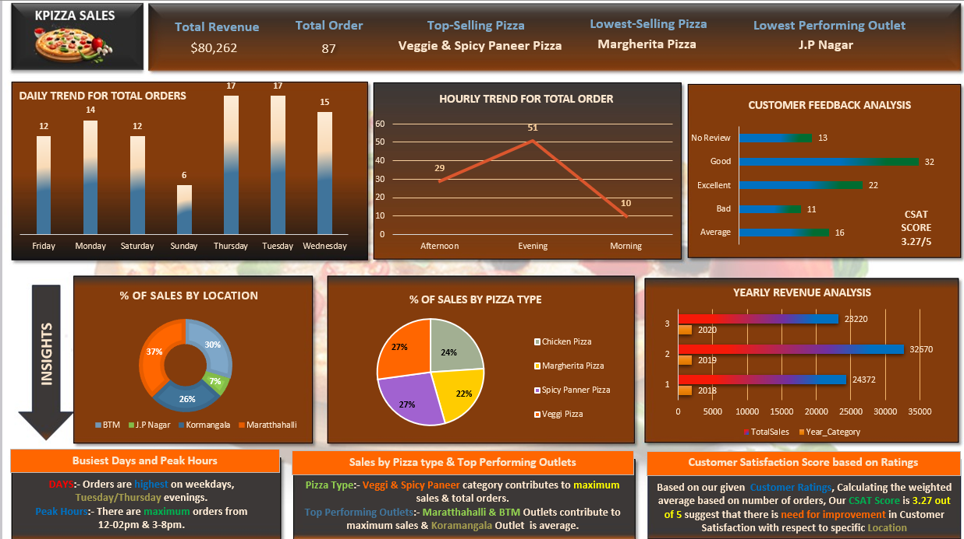
DASHBOARD

Slide 12
InTERPRETING THE RESULTS
Based on the insights derived from your data analysis project, here's a final conclusion for increasing the revenue of pizza sales and addressing identified loopholes:
Increasing Revenue:
Focus marketing efforts and promotions on weekdays, especially Tuesday and Thursday evenings, as well as during peak hours from 12-2 pm and 3-8 pm to maximize order intake.
Given that the Veggi and Spicy Paneer categories contribute to maximum sales and total orders, consider expanding and promoting these categories with new variations or deals to attract more customers.
Outlets Performance: Concentrate resources and attention on the top-performing outlets like Marathahalli and BTM, as they contribute significantly to sales. Investigate ways to boost sales at the Koramangala outlet, which is performing at an average level. For the lowest-performing outlet, J.P. Nagar, consider assessing its viability and potential improvements or alternative strategies.
Addressing Loopholes:The CSAT score of 3.27 out of 5 indicates room for improvement in customer satisfaction, particularly at specific locations. To address this, consider the following actions:
Gather feedback from customers through surveys or reviews to pinpoint areas of concern.
Implement training programs for staff to enhance service quality. Ensure consistency in food quality and delivery times.
Offer promotions or discounts for customers to incentivize feedback and improve ratings.

Slide 13

If you any questions, Feel free to ask me.
THANK YOU

